Slide 1
Hydration Level Prediction :
Using Machine Learning
Machine Learning Project | Data Science
Logistic Regression
Random Forest
XGBoost
Gradient Boosting
Dataset: 21,450 records • 5 Features • Binary Target: Hydrated / At Risk of Dehydration
RESHMA S NATH

Slide 2
Introduction
💧 Context
⚠️ Problem
Hydration is critical to physical health, athletic performance, and daily wellbeing. Many people remain unaware of their hydration status.
Manual assessment of hydration is impractical at scale. An automated, data-driven approach is essential for accurate and timely prediction.
🤖 Solution
🎯 Goal
Machine Learning classification algorithms can predict whether an individual is Hydrated or At Risk based on physiological attributes.
Build and compare 4 ML classifiers — Logistic Regression, Random Forest, XGBoost, Gradient Boosting — to identify the best model.
ML Hydration Level Prediction | Binary Classification

Slide 3
Dataset Description
Dataset Overview
Features & Target Variable
Source
Hydration Level Prediction Dataset (CSV)
Feature | Description | Type
Age | Age of individual | Numerical
Gender | Male / Female | Categorical
Weight (kg) | Body weight in kilograms | Numerical
Daily Water Intake (L) | Litres consumed per day | Numerical
Physical Activity Level | Low / Moderate / High | Categorical
Hydration Level ★ | Hydrated / At Risk of Dehydration | Target
Records
21,450 rows
Task
Binary Classification
Target
Hydrated / At Risk of Dehydration
Features
5 input variables
Preprocessing
Duplicates removed, nulls checked
ML Hydration Level Prediction | Binary Classification

Slide 4
Methodology
01
02
03
04
Data Collection
Data Cleaning
EDA
Data Transform
Loaded dataset using pandas
(21,450 records)
Checked null values; removed duplicates; verified integrity
Histograms, correlation heatmap, distribution plots
Label Encoding for categorical; Standard Scaling for numerical
05
06
07
08
SMOTE Balancing
Train-Test Split
Model Building
Deployment
Applied SMOTE to handle class imbalance before split
80% train / 20% test
(random_state=42)
4 classifiers: LR, RF, XGBoost, Gradient Boosting
Best model saved via pickle; deployed with Gradio UI
ML Hydration Level Prediction | Binary Classification

Slide 5
Exploratory Data Analysis (EDA)
Hydration Level Distribution
Key EDA Insights
📊 Dataset Shape
21,450 records × 7 columns explored via df.shape, df.info(), df.describe()
📈 Age Distribution
Range from 18–59; fairly uniform distribution across age groups
💧 Water Intake
Daily intake 0.5–5.0 litres; strong predictor of hydration status
🔥 Correlation
Water Intake & Physical Activity revealed as strongest numerical correlates
🏷️ Categorical Features
Gender (M/F), Activity Level (Low/Moderate/High) — label-encoded before training
ML Hydration Level Prediction | Binary Classification

Slide 6
Data Preprocessing & Transformation
Step 1: Check Missing Values
Step 2: Remove Duplicates
df.isnull().sum()
df = df.drop_duplicates()
✔ No missing values found in the dataset
✔ Duplicate rows identified and removed
Step 3: Label Encoding
Step 4: Feature Scaling
le.fit_transform(col) for categorical cols
StandardScaler → Weight, Water Intake
✔ Gender, Activity Level, Target encoded
✔ Continuous features normalized
Step 5: SMOTE Balancing
Step 6: Train-Test Split
SMOTE(random_state=42).fit_resample(x, y)
train_test_split(x, y, test_size=0.2, random_state=42)
✔ Class balance achieved before splitting
✔ 80% train / 20% test split applied
ML Hydration Level Prediction | Binary Classification

Slide 7
Machine Learning Models Used
📉 Logistic Regression
Linear Classifier
🌲 Random Forest
Ensemble (Bagging)
Linear model using sigmoid function for binary output. Fast, interpretable, and works well with scaled structured data.
Ensemble of decision trees using bagging. Reduces overfitting, handles complex patterns, provides feature importance.
LogisticRegression(random_state=42, max_iter=1000)
RandomForestClassifier(random_state=42)
⚡ XGBoost
Ensemble (Boosting)
📈 Gradient Boosting
Optimization-Based
Extreme Gradient Boosting framework. High accuracy with regularization; ideal for tabular datasets with mixed features.
Gradient-based optimization that iteratively updates model weights. n_estimators=100, learning_rate=0.1, max_depth=3.
XGBClassifier(eval_metric='logloss')
GradientBoostingClassifier(n_estimators=100, lr=0.1)
ML Hydration Level Prediction | Binary Classification

Slide 8
Model Evaluation Results
Performance Summary
Model | Accuracy | Rank
Random Forest | 78.84% | 🥇 1st
XGBoost | 76.59% | 🥈 2nd
Logistic Regression | 75.91% | 4th
Gradient Boosting | 76.25% | 🥉 3rd
🏆 Best Model
Random Forest — 78.84% Accuracy
ML Hydration Level Prediction | Binary Classification

Slide 9
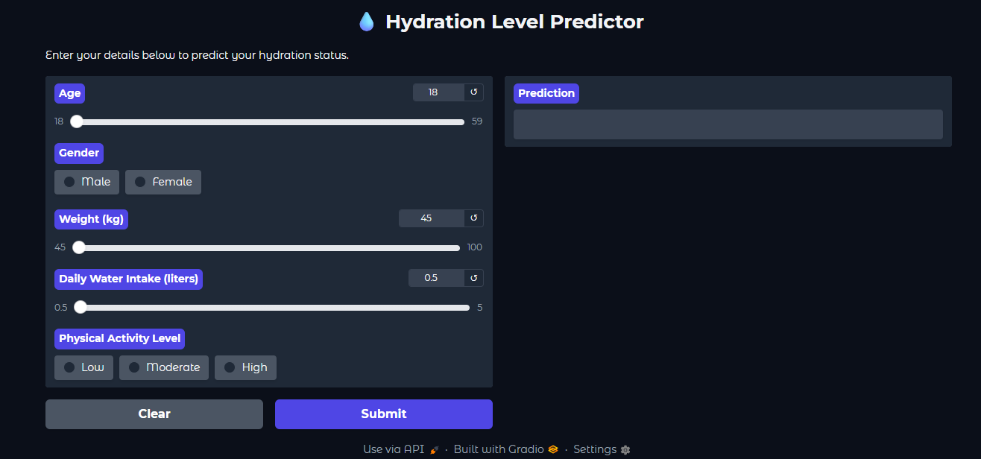
Best Model — Random Forest Classifier
🏆 Random Forest — Selected as Best Model | Accuracy: 78.84% | Saved as best_model.pkl
Why Random Forest Won
Model Deployment
Ensemble of decision trees reduces variance significantly
Handles mixed feature types (numerical + categorical) natively
Robust to outliers and noisy data
No need for feature scaling
Provides feature importance scores for interpretability
Less prone to overfitting than a single Decision Tree
ML Hydration Level Prediction | Binary Classification

Slide 10
Conclusion
🎯 Objective Met
🏆 Best Model
Successfully built a binary classifier for hydration level prediction using 4 ML algorithms on 21,450 records.
Random Forest achieved the highest accuracy (~78.84%) and was selected as the final deployed model.
🔬 Key Insight
🚀 Future Scope
Water intake and physical activity level are the strongest predictors of hydration status.
Expand dataset with real-time biometric sensors, add more features, and deploy as a mobile health app.
ML Hydration Level Prediction | Binary Classification

Slide 11
Thank You
Binary Classification of Hydration Levels
Logistic Regression
Random Forest
XGBoost
Gradient Boosting
Machine Learning Project | Data Science

